Slide 1
Appearance in front of the camera - groupwork

Slide 2
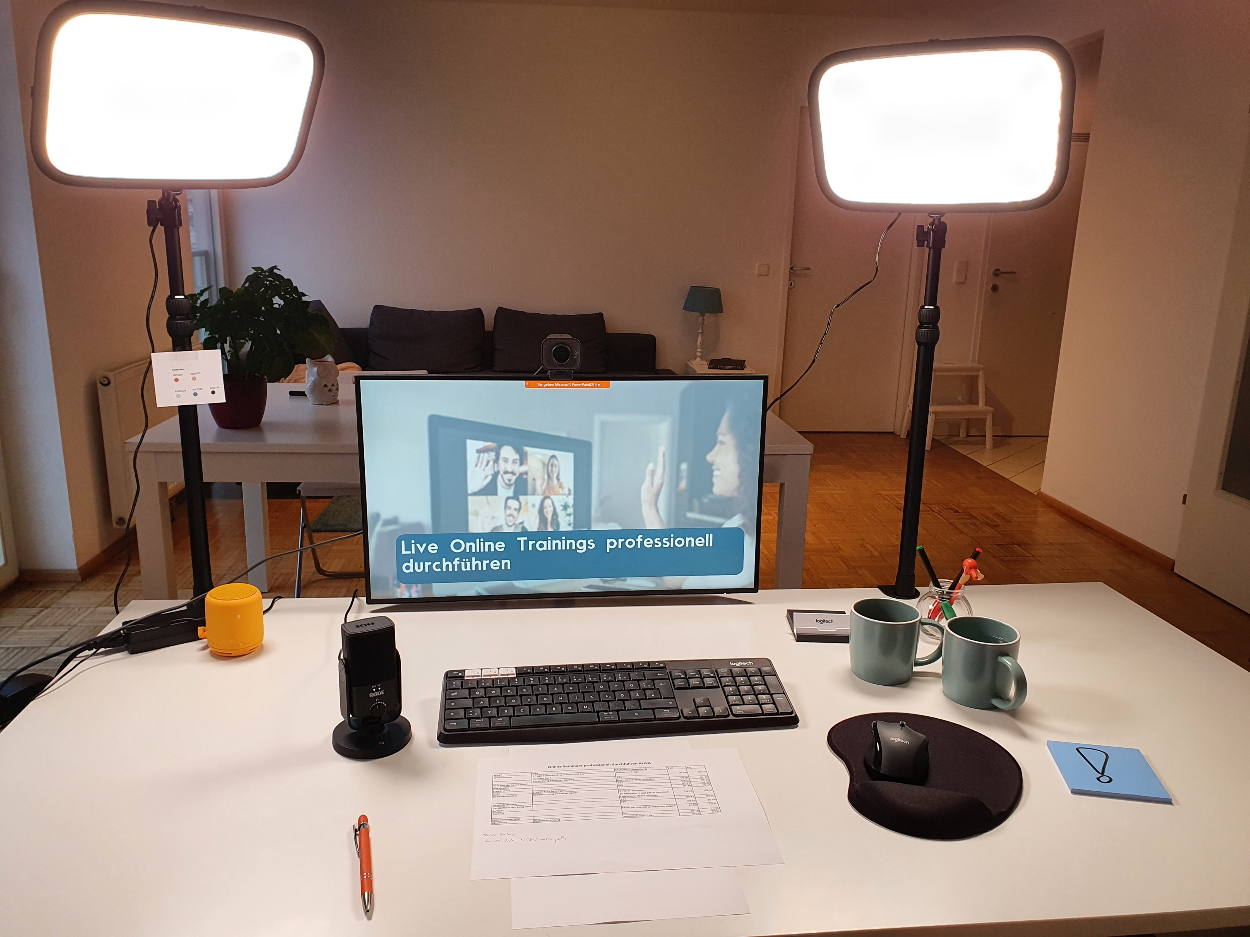
Light source from the front
Participant list + process plan
Webcam at eye-level
You don‘t see lipstick on the mug like on a glass ;-)
Coffee and water in mugs! ☺
External microphone when needed

Slide 3
DELETE THE FORM TO SEE THE SOLUTION
Light source from the front
Webcam at eye-level
Coffee and water in mugs! ☺
You don‘t see lipstick on the mug like on a glass ;-)
External microphone when needed
Participant list + process plan

Slide 4
Eye contact and way of speaking
Look directly into the camera
Why?
Let people know what you‘re doing when you‘re trying to fix a problem
Why?

